Slide 1
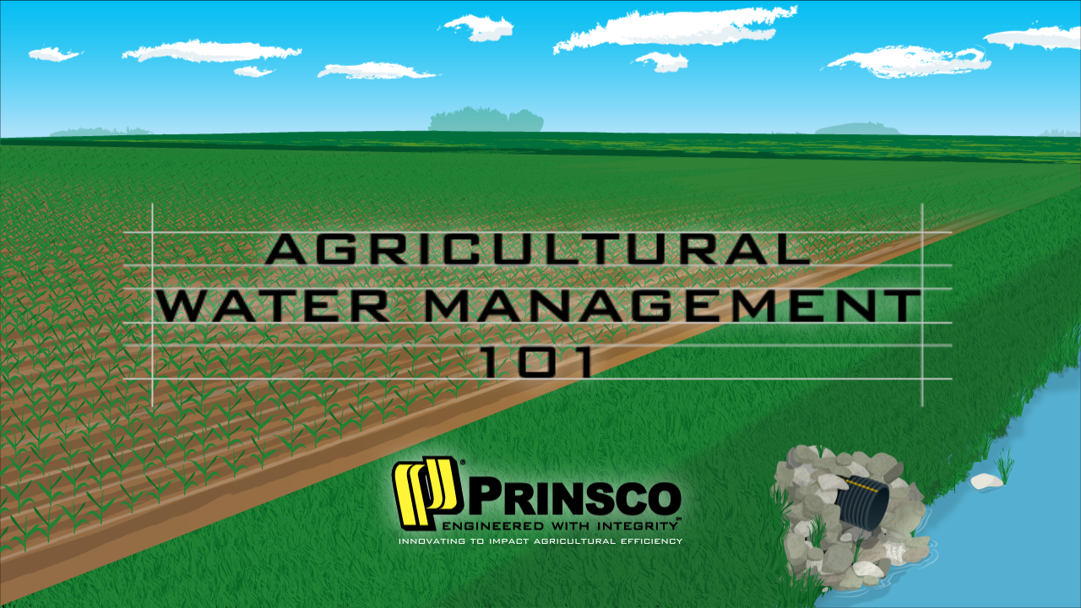
Notes:
Welcome to Agricultural Water Management 101, by Prinsco, a family owned company innovating to impact agricultural efficiency since 1975. This presentation will take you through the basics of effective water management in an agricultural application.

Slide 2
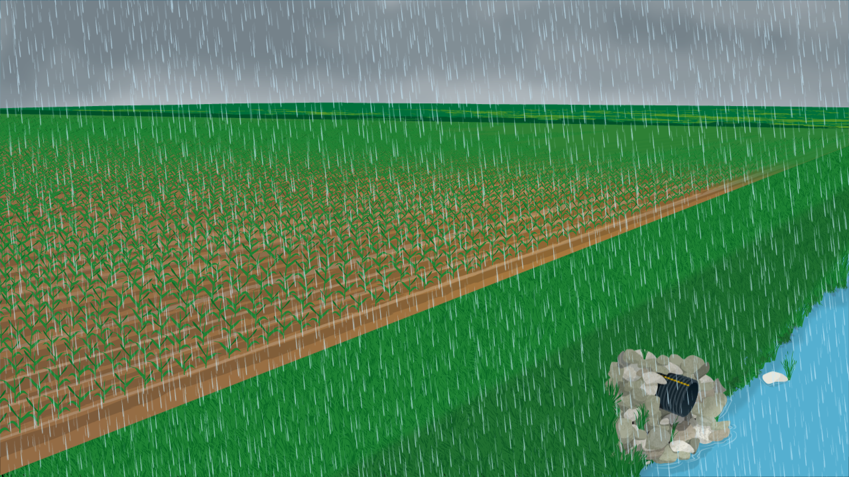
Notes:
There is no question that the most uncontrollable element in farming is weather. Subsurface water management gives producers an opportunity to regain some control from unpredictable weather. Raising a successful crop every year requires proper soil management both at the surface and below ground.

Slide 3
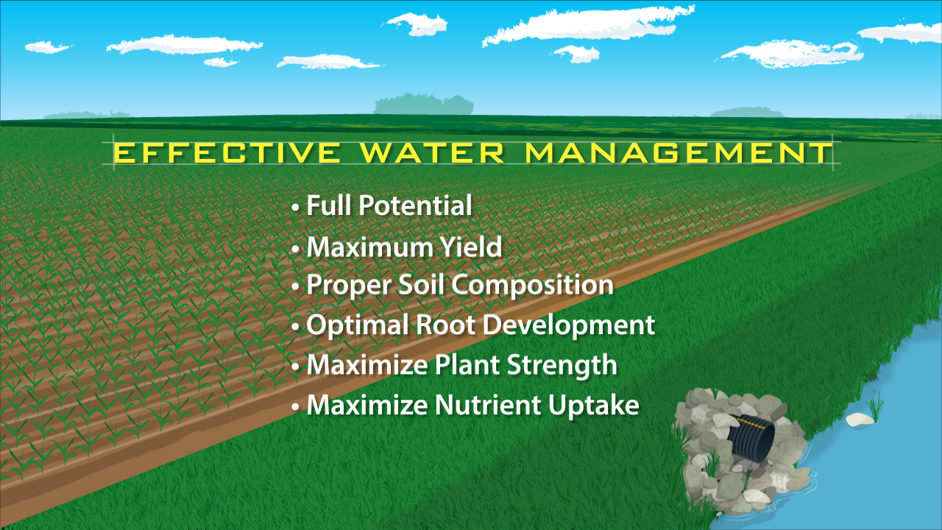
Notes:
An effective water management system is essential for crops to attain their full potential and maximum yield. It allows for proper soil composition and optimal root development, maximizing plant strength and nutrient uptake.

Slide 4
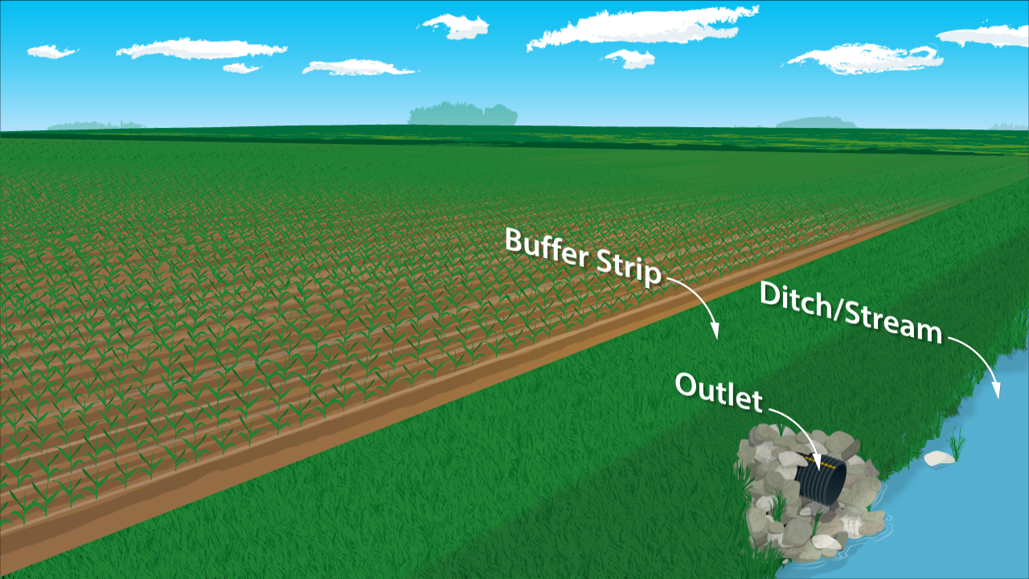
Notes:
The key visible features of a water management system include the outlet, a ditch or stream to carry excess water away, and a buffer strip to shield the stream from overland soil erosion.

Slide 5
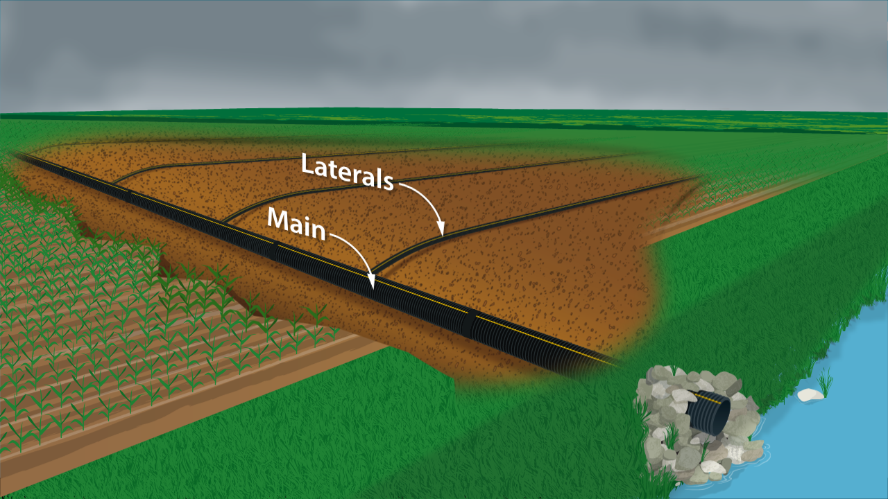
Notes:
As rain enters the system, it is what happens below ground that makes a water management system so valuable.
The larger diameter pipe is called a “main.” The job of the main is to take excess water from the field and direct it out of the system.
The smaller pipes are called “laterals,” and form a pattern or grid across the field, collecting excess moisture, and carrying that water to the main.

Slide 6
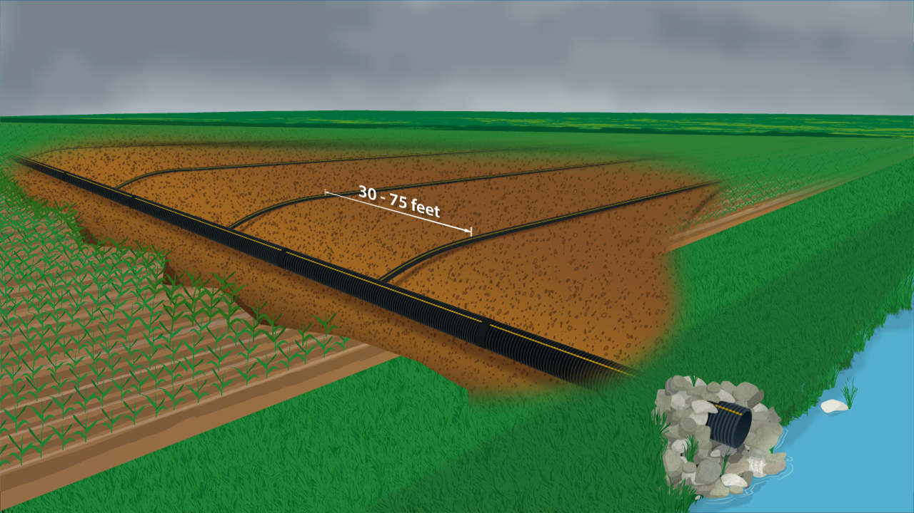
Notes:
Laterals are usually spaced 30-75 feet apart,

Slide 7
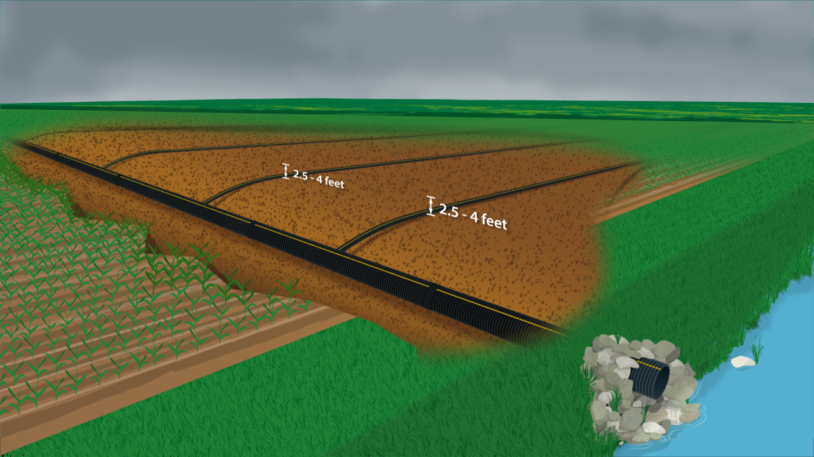
Notes:
and are buried 2.5-4 feet deep depending on soil type.

Slide 8
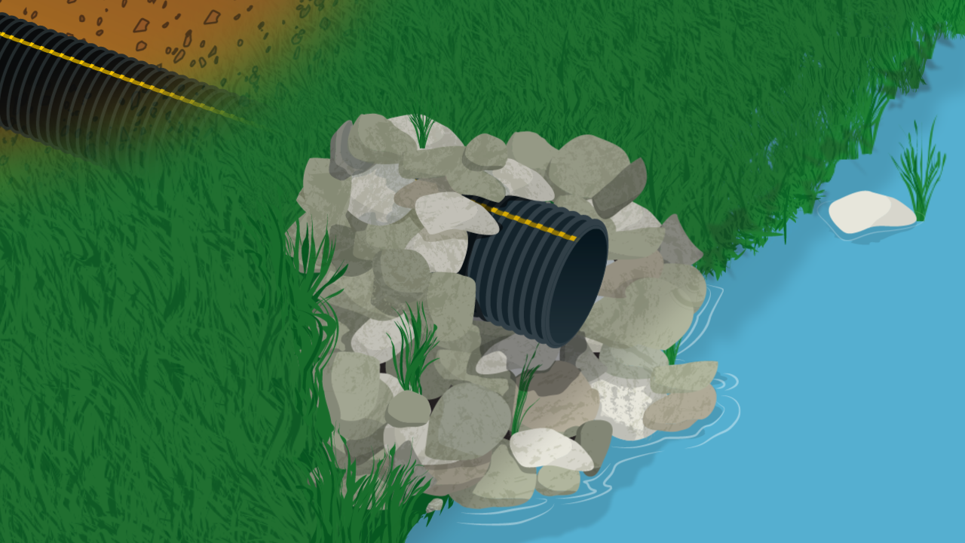
Notes:
The main is always deeper than the laterals as water moves through the system using gravity. Water flows to the lowest point, which is always the outlet.

Slide 9
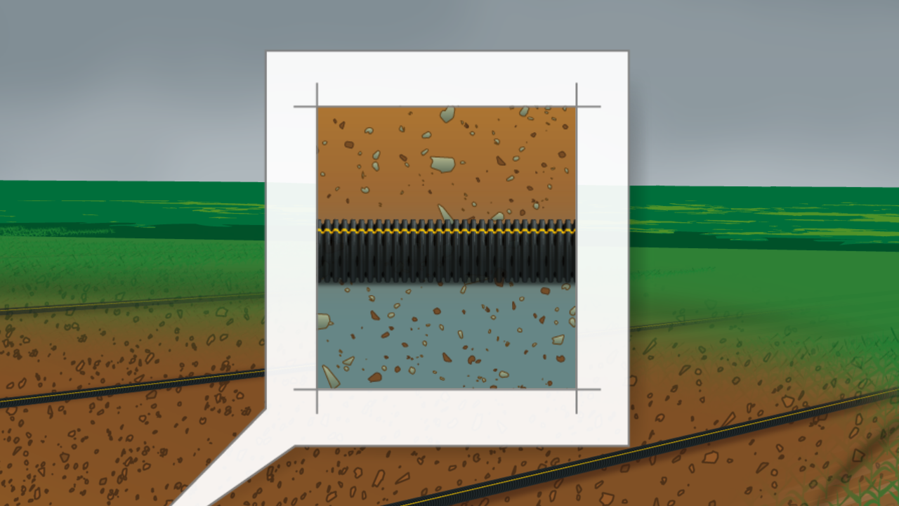
Notes:
Water enters the laterals through small perforations or slits in the pipe. The perforations are designed to allow water in and keep soil out.

Slide 10
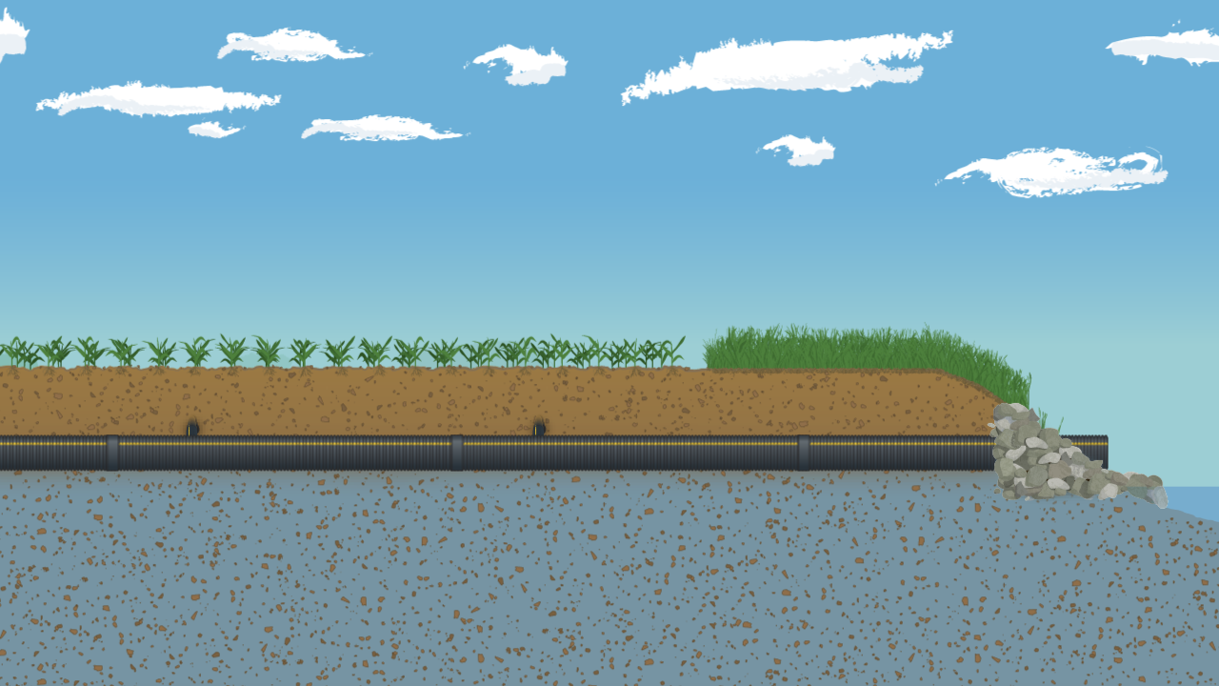
Notes:
From a side view, we see the main.

Slide 11

Notes:
Note the water table is just below the main. A properly designed water management system does not take all of the water out of the soil.

Slide 12

Notes:
It manages the water table to keep it at a constant depth, which is usually 3-5 feet below the soil surface.

Slide 13
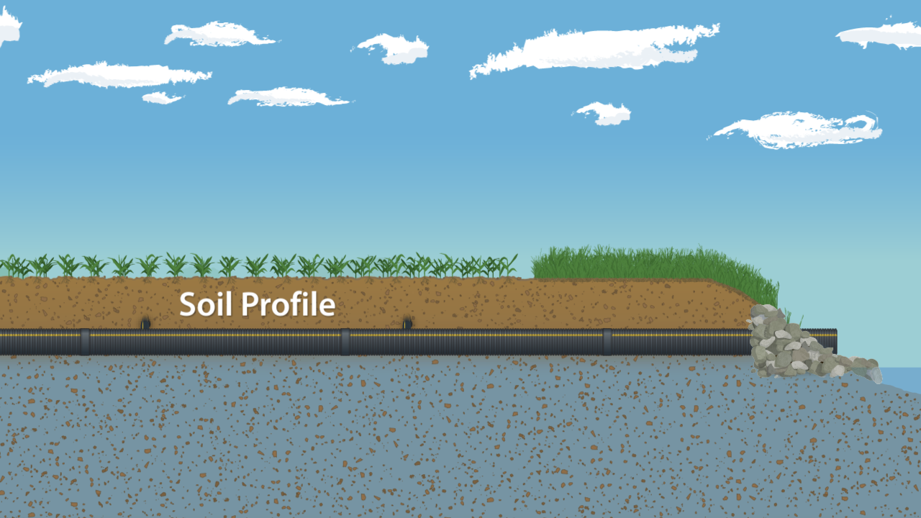
Notes:
By managing the water table, the optimal soil profile for plant growth is achieved. The soil profile is the area from the soil surface to 2.5-4 feet below. This area is where nutrients are taken up by plant roots.

Slide 14
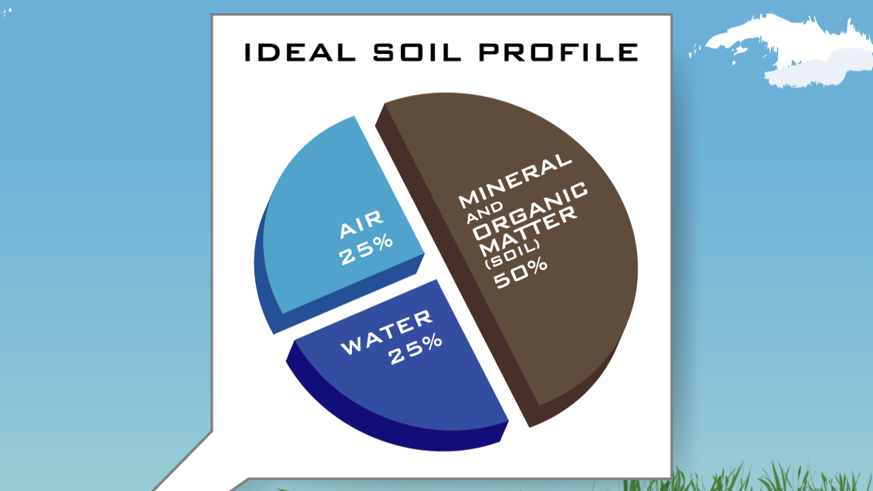
Notes:
Ideal soil properties in the profile are 50% minerals and organic matter, 25% air and 25% water.

Slide 15

Notes:
A cross section of the main reveals the laterals entering, allowing the water to flow “downhill” into the main.

Slide 16
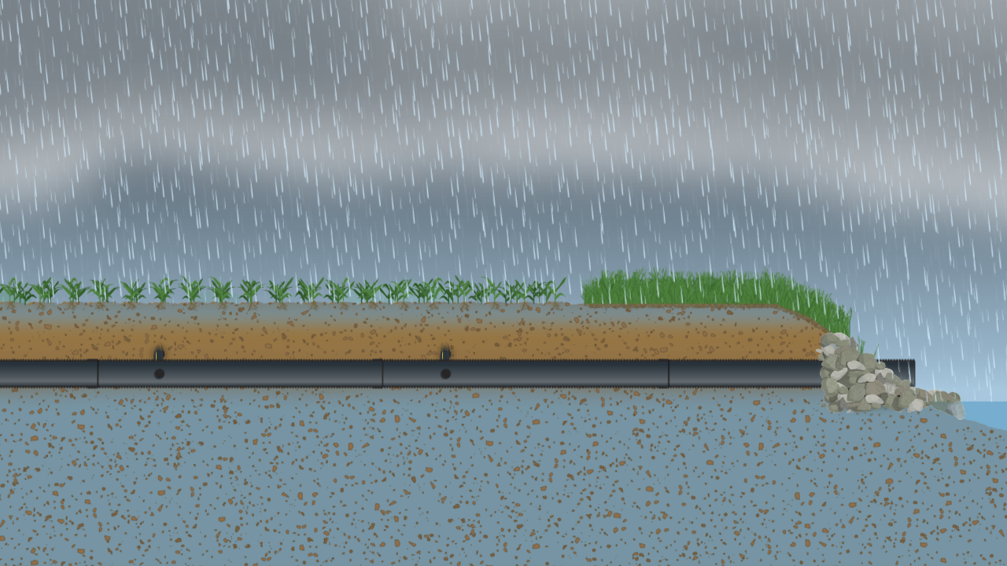
Notes:
As rain begins above ground, the soil profile is able to accept water from the surface as it filters down.

Slide 17
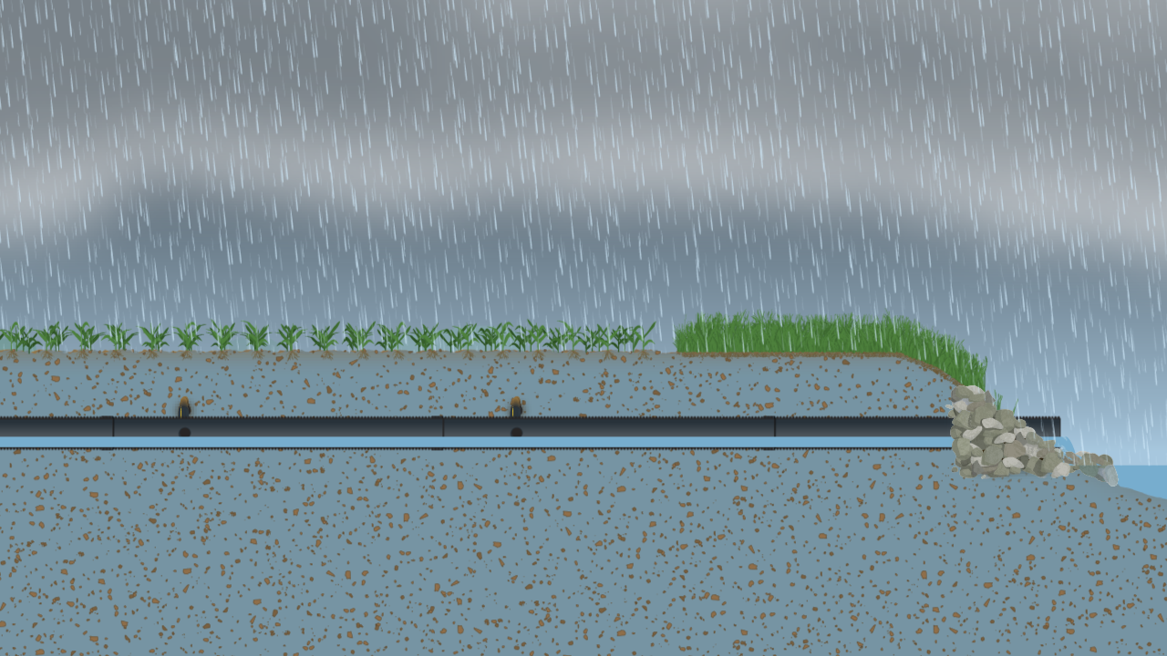
Notes:
Once the water reaches the perforated laterals, excess water enters the system and begins flowing to the main.

Slide 18
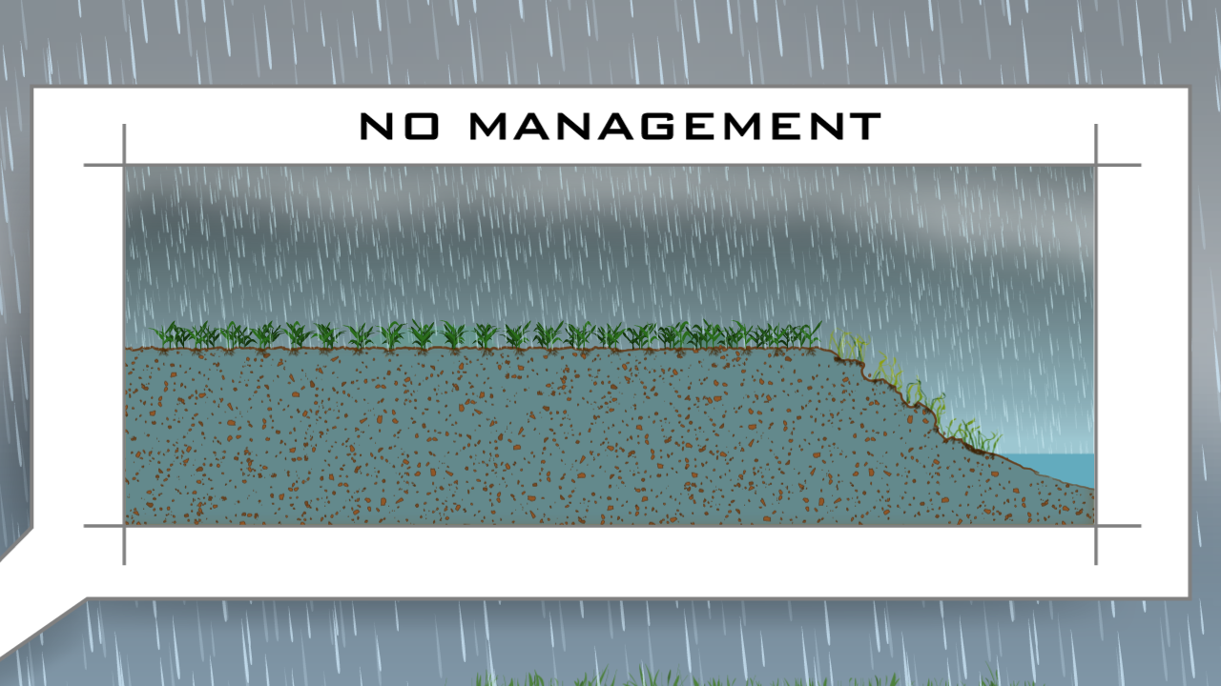
Notes:
Compare that with the same field without a water management system. Typically, the water table is higher with less area available to absorb water.

Slide 19
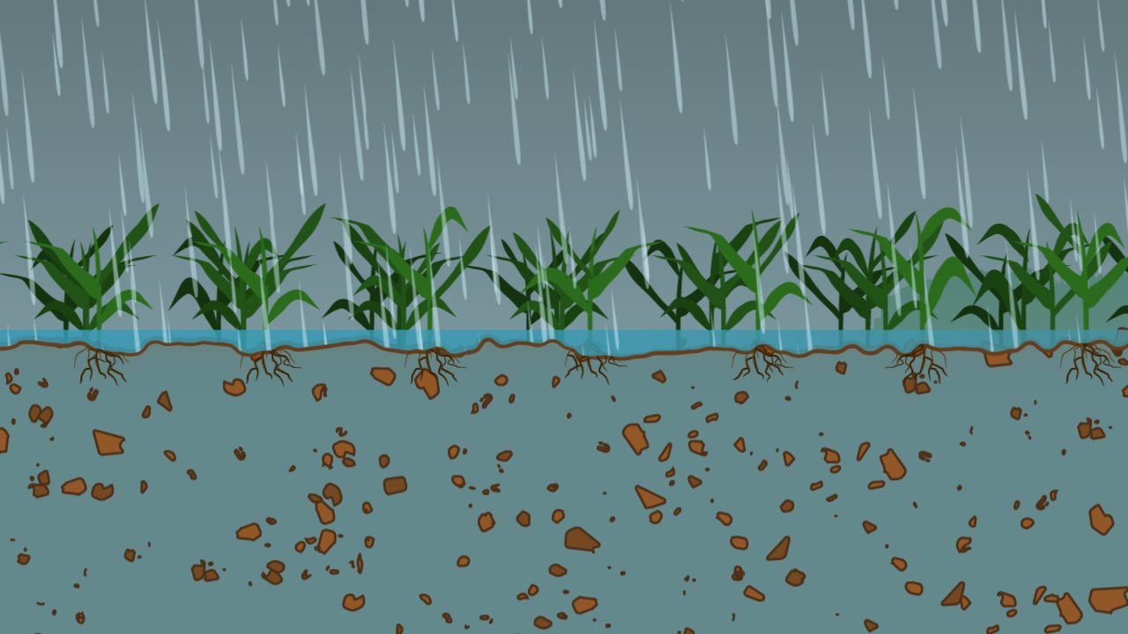
Notes:
When the soil reaches full saturation and rain continues, excess water cannot soak into the ground. The only place for excess water to go is flow overland to the lowest point, carrying with it valuable soil and nutrients.

Slide 20
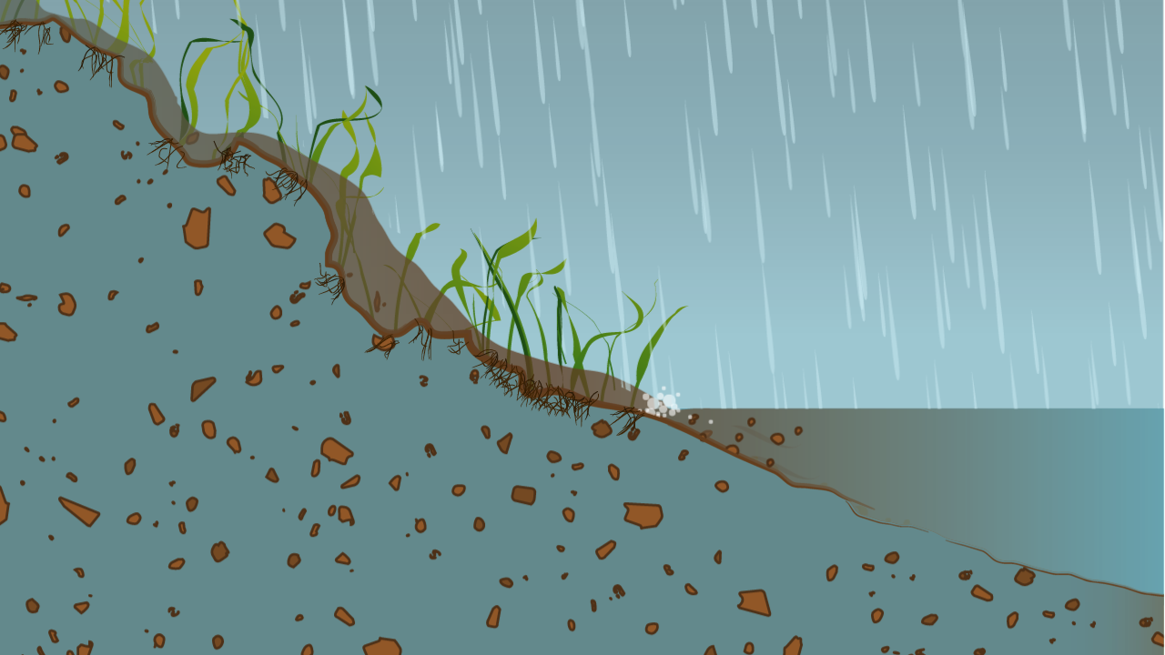
Notes:
This will cause erosion of surface soil, dumping sediment and nutrients into the ditch or stream.

Slide 21
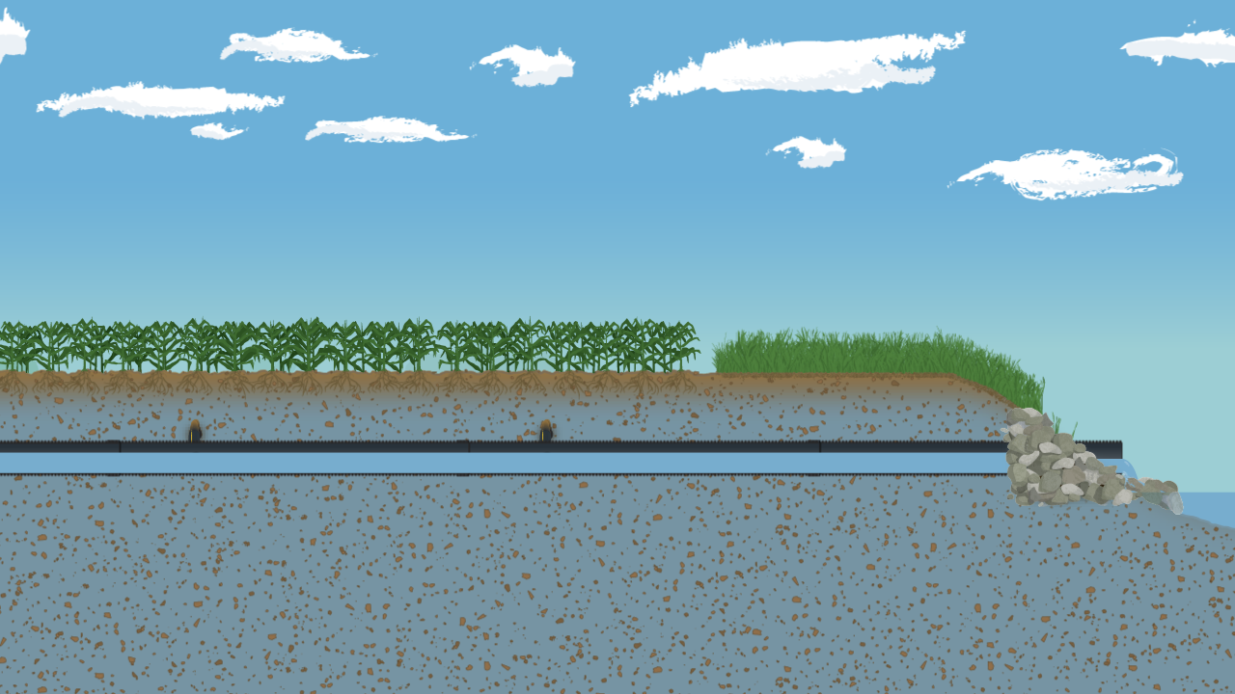
Notes:
A water management system allows more water to be filtered through the soil and less risk of soil erosion. As the soil profile reaches full saturation and rain ends, excess water filters down to the laterals, into the main, and out of the system through the outlet. This reduces the amount of water in the soil profile.

Slide 22
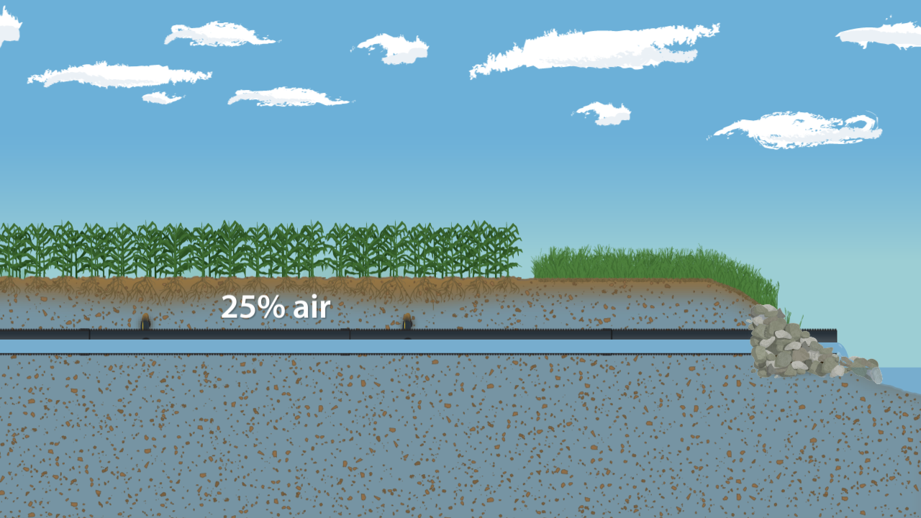
Notes:
It is important to recall for optimal plant health, 25% of the soil profile should be air. If not, plant roots will be deprived necessary oxygen, and cause plant death

Slide 23
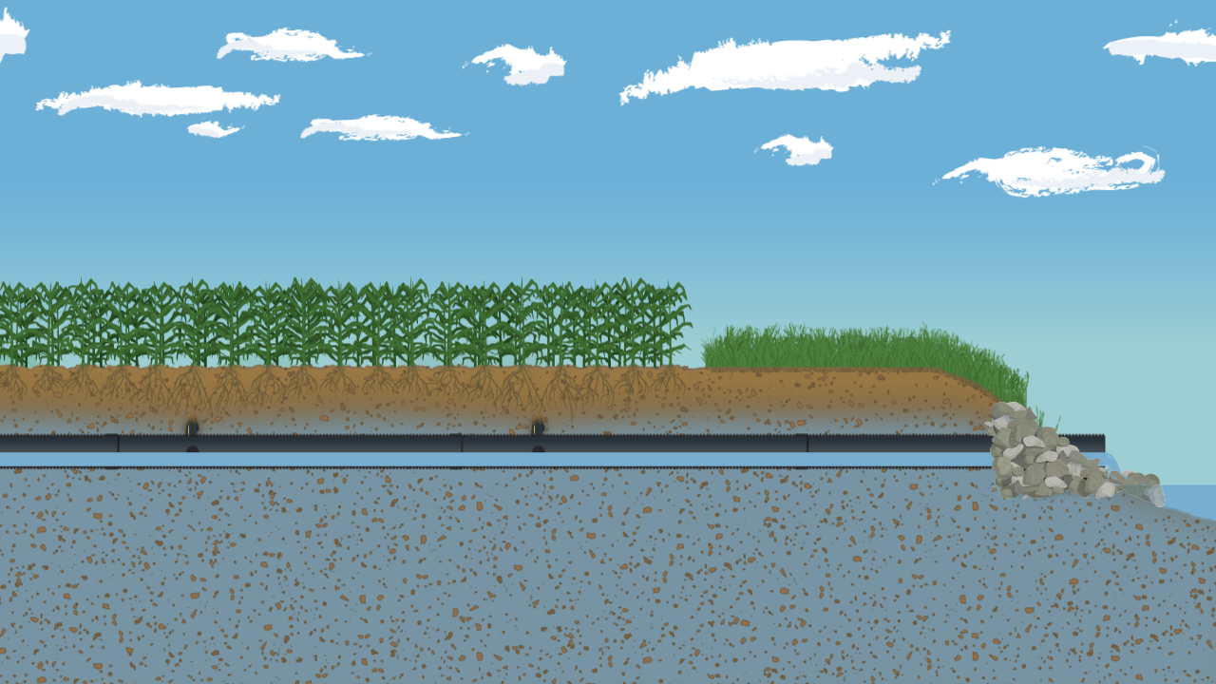
Notes:
As excess water leaves the main into the ditch or stream, the soil profile continues to take in needed oxygen. Plant roots continue to grow, pushing deeper as the water table retreats. It is critical for young plants to establish deep roots early in life.

Slide 24
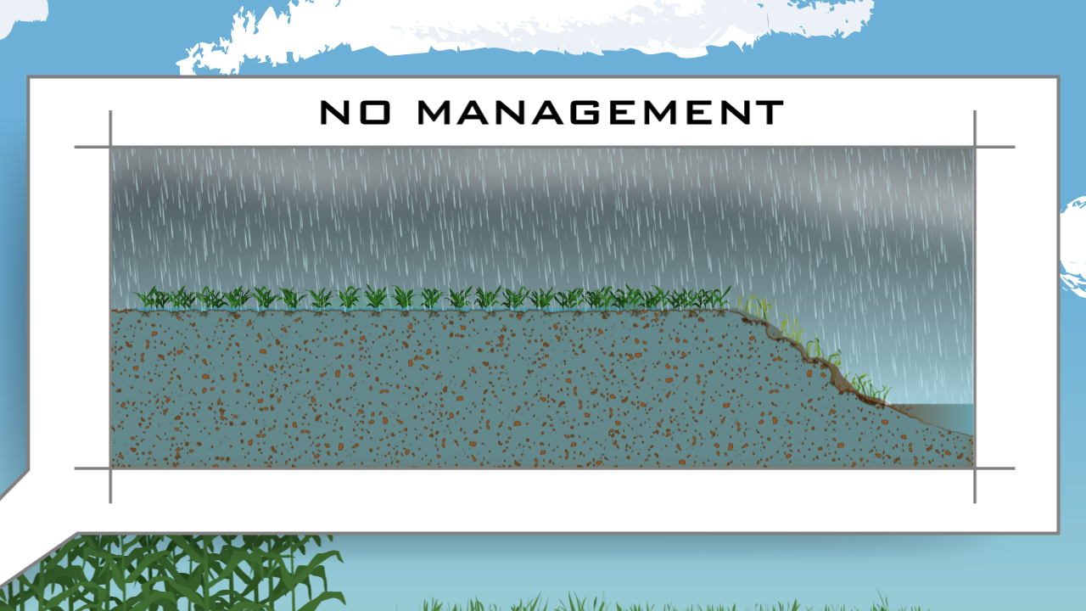
Notes:
If the water table is at or near the surface for an extended period of time, plant roots have no need to grow deeper seeking water.

Slide 25
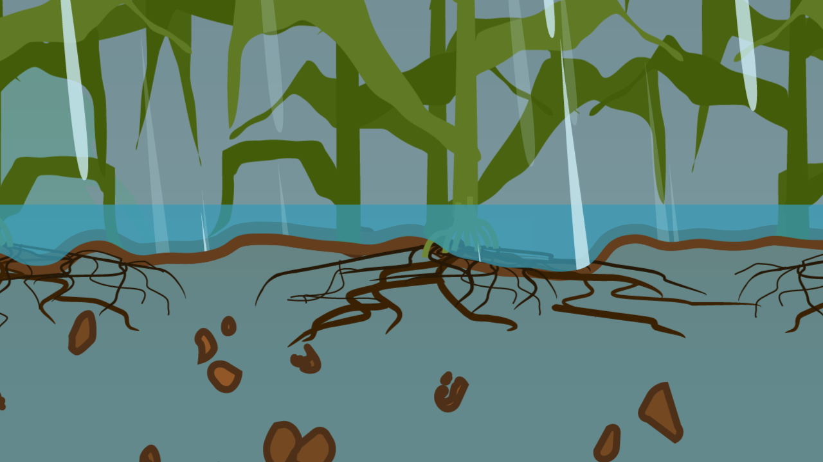
Notes:
Instead they form shallow root systems. As the growing season progresses, extended dry weather stresses plants as the shallow roots are unable to turn downward and capture moisture from the retreating water table.

Slide 26
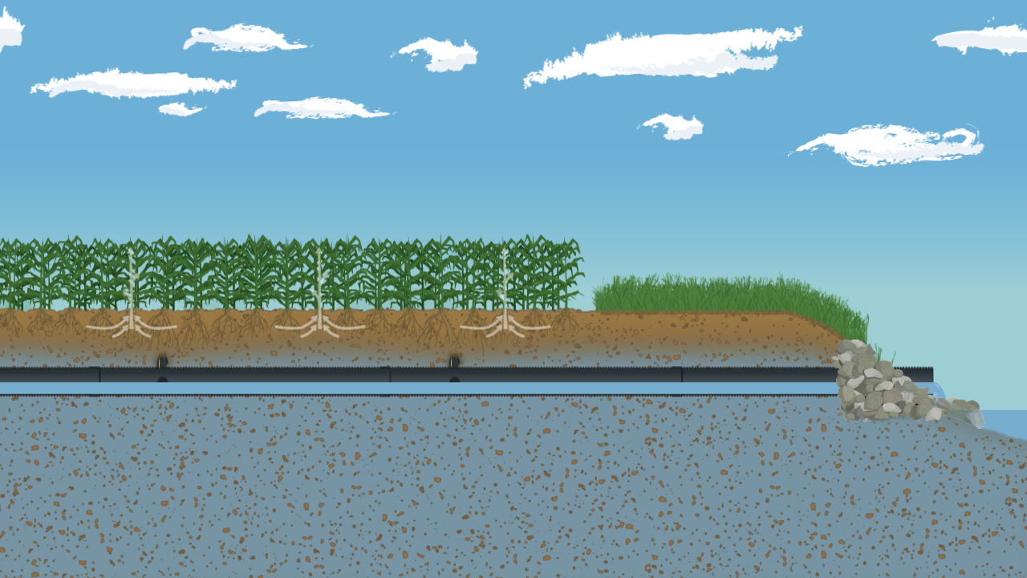
Notes:
By managing the water table, plant roots thrive in an ideal soil profile. Nutrient uptake is maximized, and deep roots are established early, benefiting the plant the entire growing season.

Slide 27
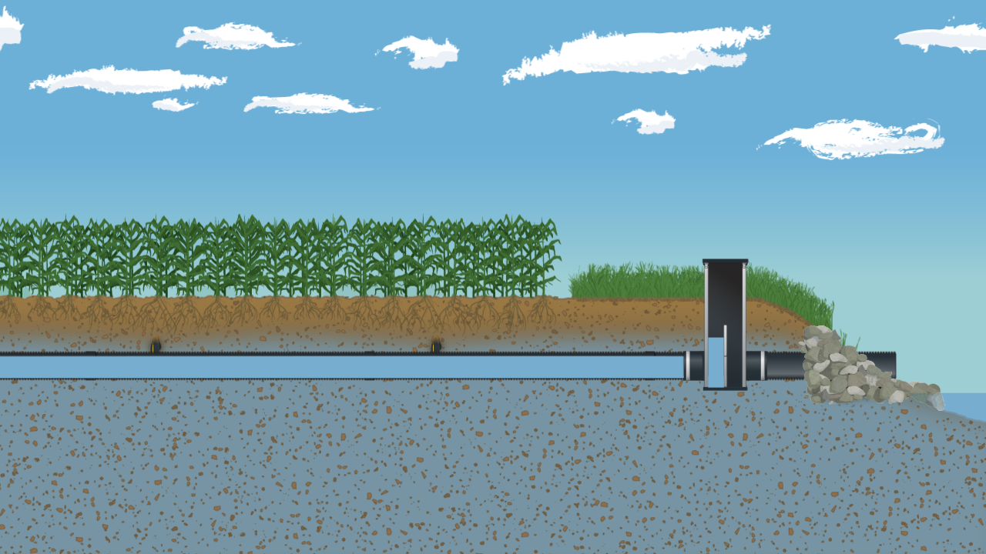
Notes:
In line water control structures are a great addition to a water management system. This unit is installed at the lowest point in the system, usually near the outlet on the main.
A water control structure features adjustable stop logs that can be added or removed depending on the time of year and weather conditions.
When an extended dry period is anticipated, the stop logs are placed in the structure at a level that will temporarily raise the water table. As water enters the system, it is held in the pipes leaving additional moisture in the soil profile for thirsty plants.

Slide 28
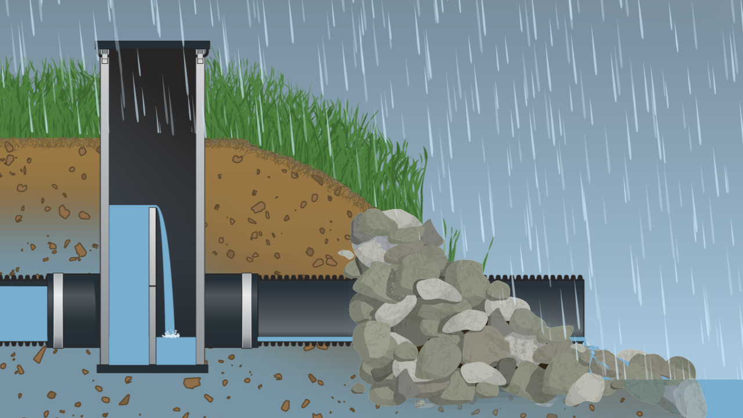
Notes:
When the system is saturated and the pipes are full, excess water flows over the stop logs and through the outlet.

Slide 29
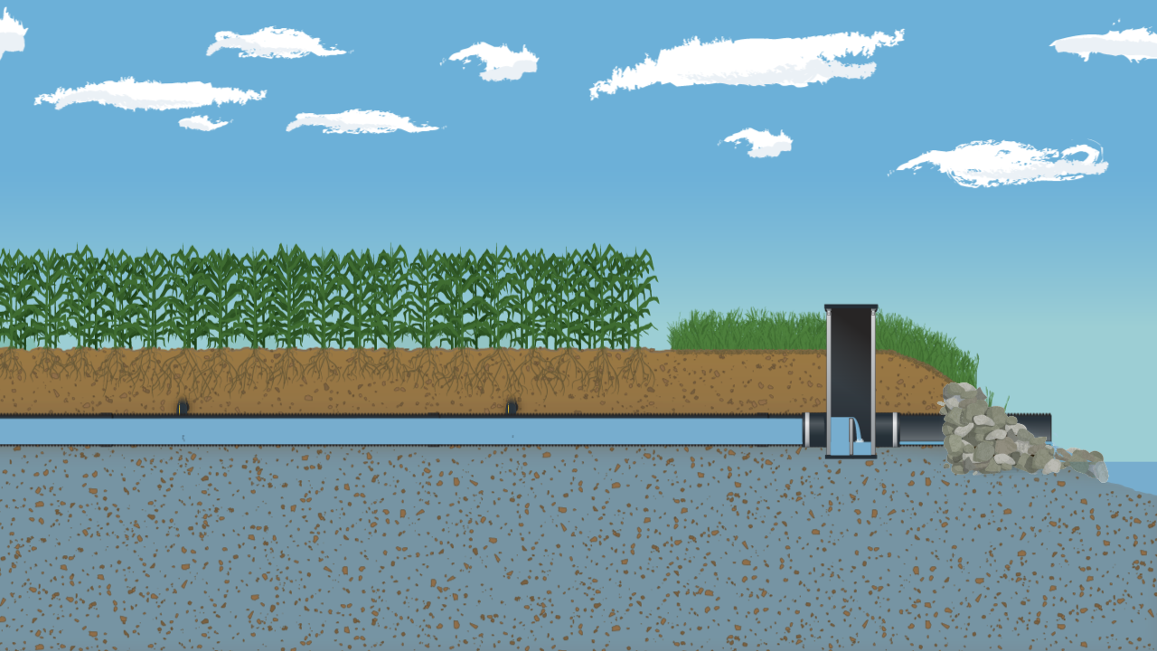
Notes:
Stop logs can be adjusted to hold water in the system, particularly after planting in the spring and prior to extended dry periods throughout the growing season.

Slide 30
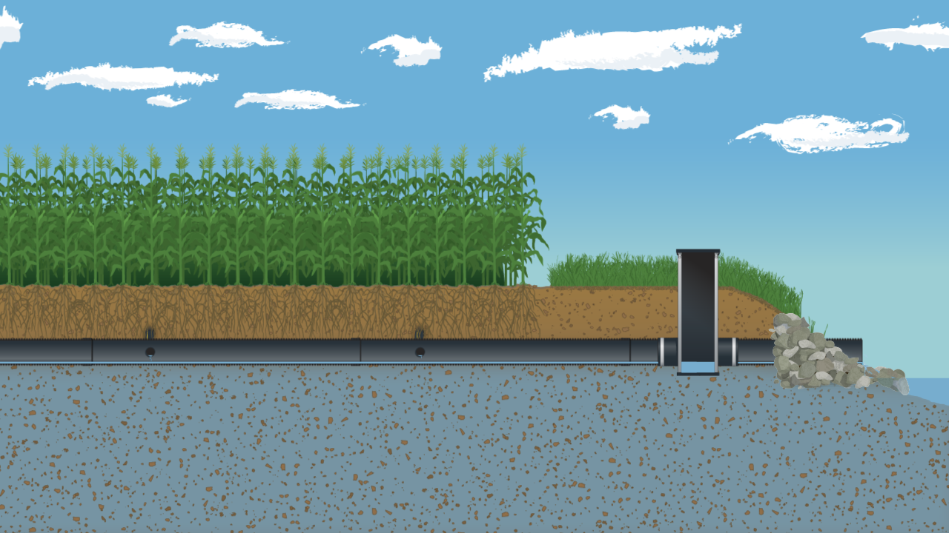
Notes:
If excess water conditions are present, stop logs can be removed allowing water to flow out of the soil profile, especially prior to spring planting and fall harvest.

Slide 31
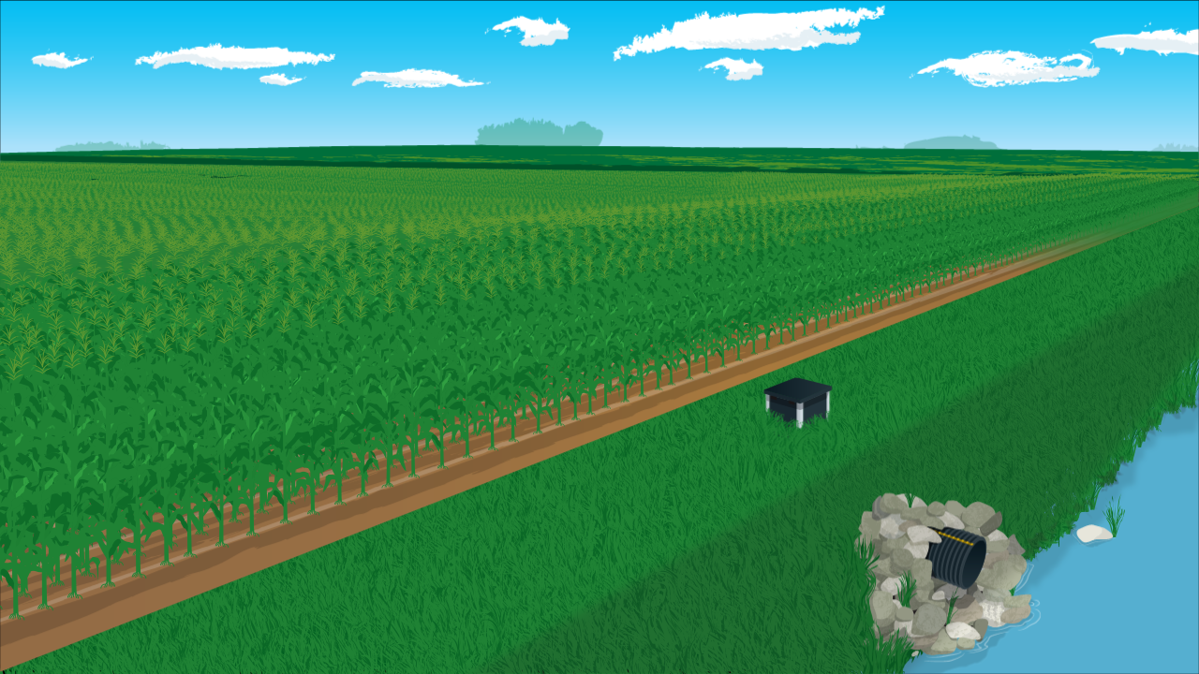
Notes:
Managing the soil profile with a water management system has tremendous benefits. It is an affordable tool producers can use to directly impact the health of their crops during the growing season.

Slide 32
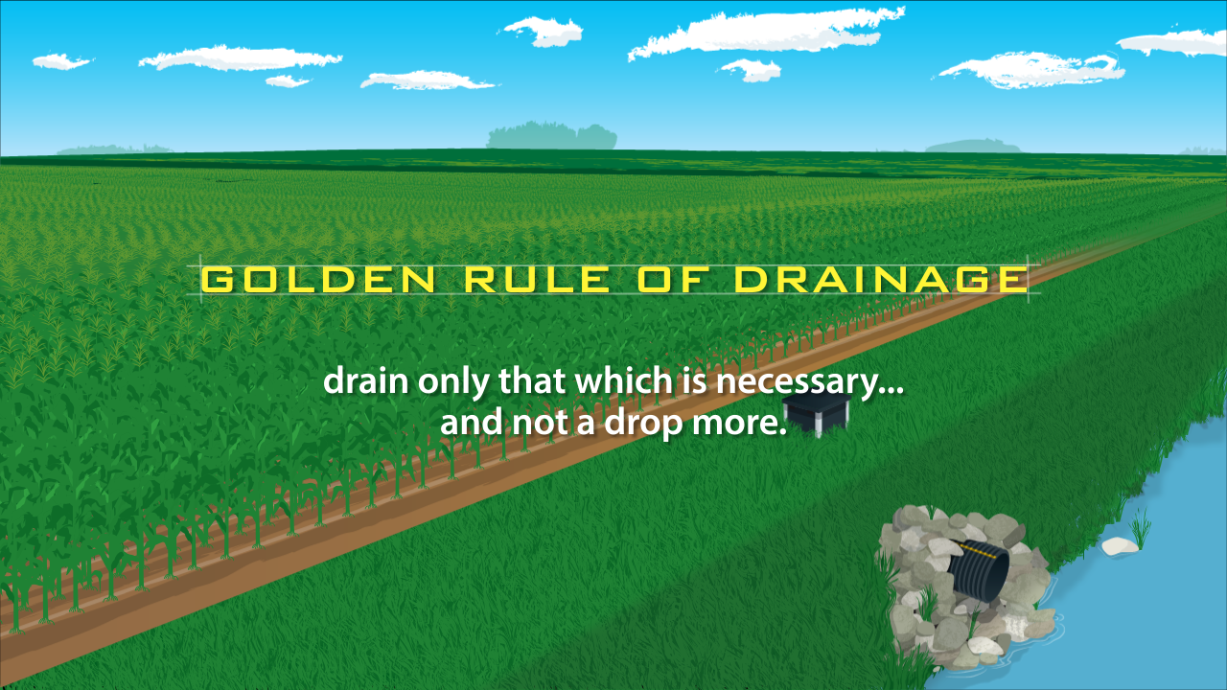
Notes:
Keep in mind the Golden Rule of Drainage – drain only that which is necessary to ensure trafficability and crop production – and not a drop more.

Slide 33
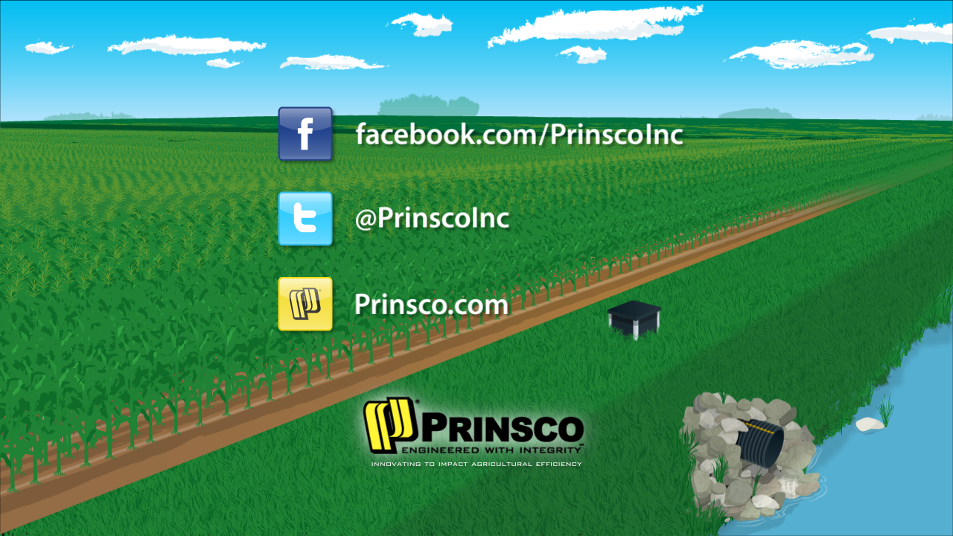
Notes:
For more information visit us at facebook.com/PrinscoInc. On twitter @PrinscoInc. On the web at Prinsco.com

